Slide 1
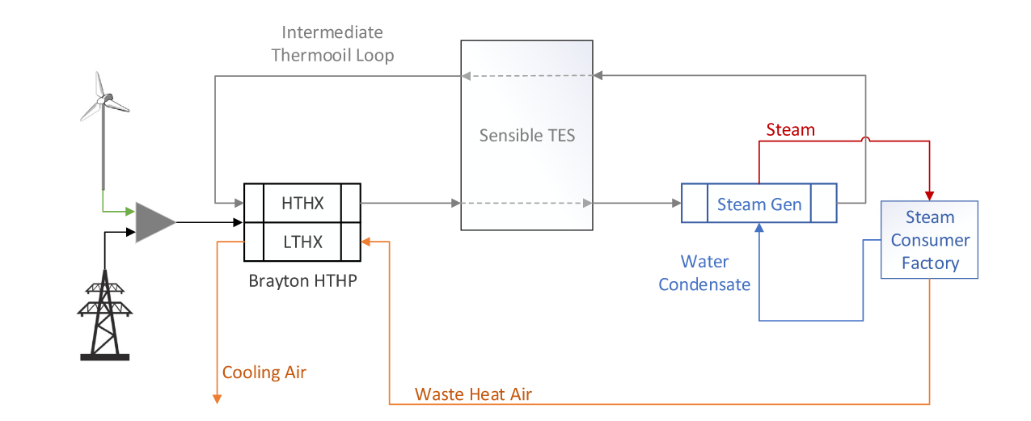
Illustration of the investigated industrial energy conversion system for electrified steam generation. The system consists of a HTHP, a TES and a SG, where the HTHP is powered by electricity from a wind turbine or the power grid. The HTHP uses waste heat air stream as a heat source and enables charging and discharging of the TES via an intermediate thermal oil stream. Furthermore, constant heat demand for the steam consumer factory must be satisfied.

Slide 2
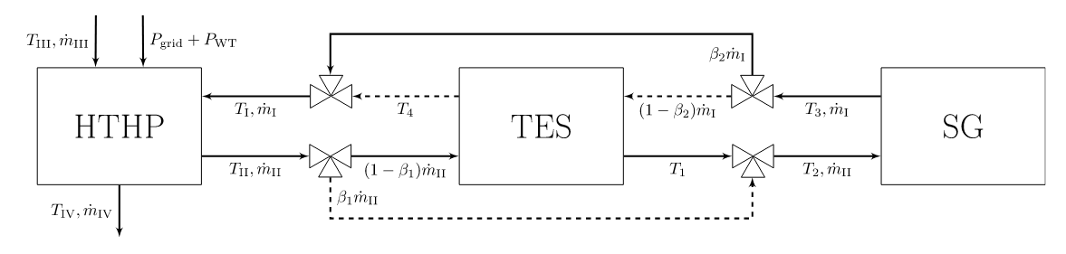
Detailed flow chart of studied system including HTHP, TES and SG. HTHP and SG are represented by polynomial surrogate models, while TES is modeled by an effectiveness model. An adjustable fluid bypass β1 ∈ [0, 1] is used to control the heat input to the TES and SG, conversely the bypass β2 ∈ [0, 1] regulates the heat input to the HTHP depending on the thermal state Ts of the TES and SG outlet stream. The solid and dashed lines indicate the charging and discharging mode in a simplified way. In addition, simultaneous charging and discharging is not allowed. For example, charge mode is β1 ∈ [0, 1), β2 = 1, discharge mode implies β2 ∈ [0, 1), β1 = 1, and idle mode represents β1 = β2 = 1

Slide 3
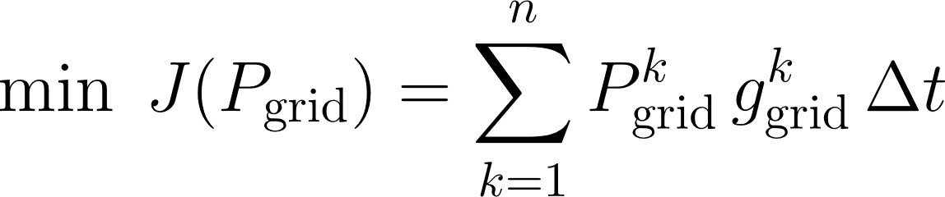
Minimize total operational cost:
Cost depends on:
Electricity purchased from the grid P^{k}_{grid}
Time-varying electricity prices g^{k}_{grid}
Notes:
Obj- \min \; J(P_{\mathrm{grid}})=\sum_{k=1}^{n} P_{\mathrm{grid}}^{k}\, g_{\mathrm{grid}}^{k}\,\Delta t
codecogs

Slide 4
Constraint-1
Power Balance Constraint
Ensures:
Energy supply = energy demand
Total power input (grid + wind) must equal to:
Power required by the heat pump system
Includes:
Grid power
Wind turbine power
Heat pump consumption
Constraint-2,3
These are nonlinear surrogate models
They compute temperatures based on:
Flow rate
Temperatures
Compressor speed
Notes:
P_{\mathrm{grid}}^{k}+P_{\mathrm{WT}}^{k}=3F_{\mathrm{HTHP}}\!\left(T_I^{k},\dot{m}_I^{k},T_{III}^{k},R^{k}\right)
T_{II}^{k}=F_{\mathrm{HTHX}}\!\left(T_I^{k},\dot{m}_I^{k},T_{III}^{k},R^{k}\right)
T_{IV}^{k}=F_{\mathrm{LTHX}}\!\left(T_I^{k},\dot{m}_I^{k},T_{III}^{k},R^{k}\right)

Slide 5
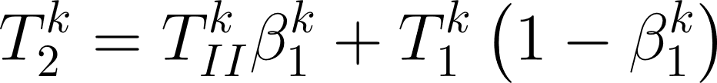
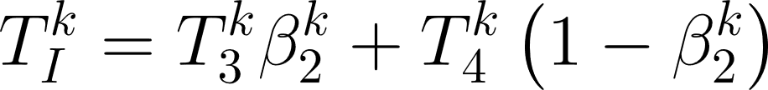
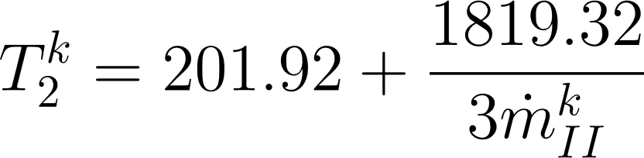
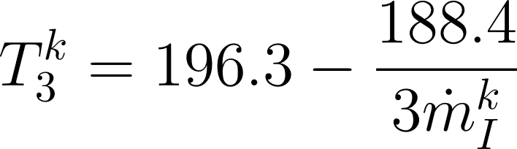
Constraint-4,5
Control variables β1,β2∈[0,1]
Define how heat is routed in the system
Control whether energy:
Goes to storage
Bypasses storage
Returns to the heat pump
Constraint-6,7
Relate temperature and mass flow rate
Ensure required steam temperature conditions are satisfied.
Notes:
4. T_{2}^{k}=T_{II}^{k}\beta_{1}^{k}+T_{1}^{k}\left(1-\beta_{1}^{k}\right)
5. T_{I}^{k}=T_{3}^{k}\beta_{2}^{k}+T_{4}^{k}\left(1-\beta_{2}^{k}\right)
6. T_{2}^{k}=201.92+\frac{1819.32}{3\dot{m}_{II}^{k}}
7. T_{3}^{k}=196.3-\frac{188.4}{3\dot{m}_{I}^{k}}

Slide 6
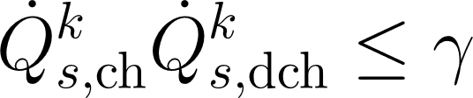
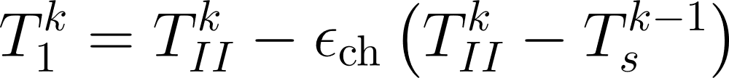
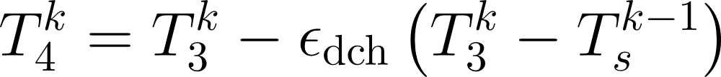
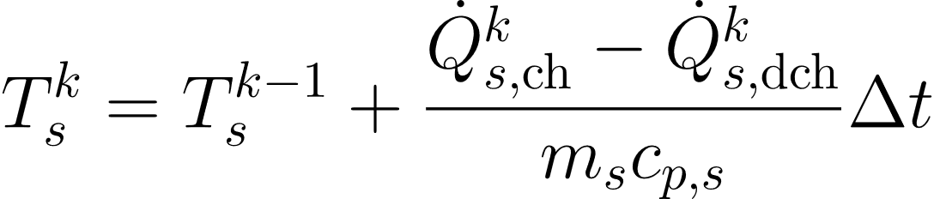
Constraint-8,9
Thermal Energy Storage (TES)
Charging
Discharging
Define heat flow into and out of storage:
TES stores excess heat and releases it when needed.
Constraint-10
No Simultaneous Charge & Discharge
Prevents charging and discharging at the same time
Constraint-11,12,13
Storage Temperature Dynamics
Storage temperature evolves over time(dynamic behaviour)
Notes:
8. \dot{Q}_{s,\mathrm{ch}}^{k} =3\dot{m}_{II}^{k}c_{p,f}\left(T_{II}^{k}-T_{1}^{k}\right)\left(1-\beta_{1}^{k}\right)
9. \dot{Q}_{s,\mathrm{dch}}^{k} =3\dot{m}_{I}^{k}c_{p,f}\left(T_{4}^{k}-T_{3}^{k}\right)\left(1-\beta_{2}^{k}\right)
10. \dot{Q}_{s,\mathrm{ch}}^{k}\dot{Q}_{s,\mathrm{dch}}^{k}\le \gamma
11. T_{1}^{k}=T_{II}^{k}-\epsilon_{\mathrm{ch}}\left(T_{II}^{k}-T_{s}^{k-1}\right)
12. T_{4}^{k}=T_{3}^{k}-\epsilon_{\mathrm{dch}}\left(T_{3}^{k}-T_{s}^{k-1}\right)
13. T_{s}^{k}=T_{s}^{k-1}+\frac{\dot{Q}_{s,\mathrm{ch}}^{k}-\dot{Q}_{s,\mathrm{dch}}^{k}}{m_sc_{p,s}}\Delta t

Slide 7
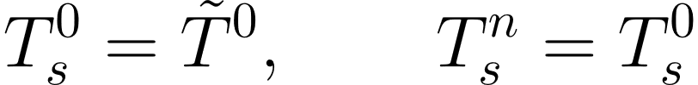
Constraint-14
Boundary Conditions
Initial and final storage temperature must match
Ensures cyclic daily operation
Constraint-15
Operational Limits
Limits on:
Temperature
Flow rate
Compressor speed
Constraint-16
Time Discretization
System is optimized over discrete time steps
Notes:
14. T_{s}^{0}=\tilde{T}^{0}, \qquad T_{s}^{n}=T_{s}^{0}
15. T_{I}^{k}\in[177,250], \qquad \dot{m}_{I}^{k}\in[5,16]
16. T_{III}^{k}\in[60,100], \qquad R^{k}\in[0.8,1.53]
17. t_k=\Delta t\,k, \qquad k=1,\dots,n

Slide 8
Thank You!
I appreciate your time and attention.

